Slide 1
Department
of
Computer Science & Engineering

Slide 2

Minor Project Topic
SMART LEARNING WEBSITE
Project Guide:
Ms. Manisha Kadam
Team Members:
Esha Jawade
Harsh Khatod
Darshan Paliwal
Aditya Bagate

Slide 3

Technology Used
1.Frontend: HTML, CSS, and JavaScript.
2.Backend: Node.js(JavaScript), Python(Django or Flask), PHP, MySQL.
3.Android: Java Android Studio IDE.
4. Animation Creation: Adobe After Effects, Blender & AI.

Slide 4
Problem Statement
To create a website that runs smartly in the way that it saves our time in searching for content and make kids interest in your website with Learn and Play together.

Slide 5
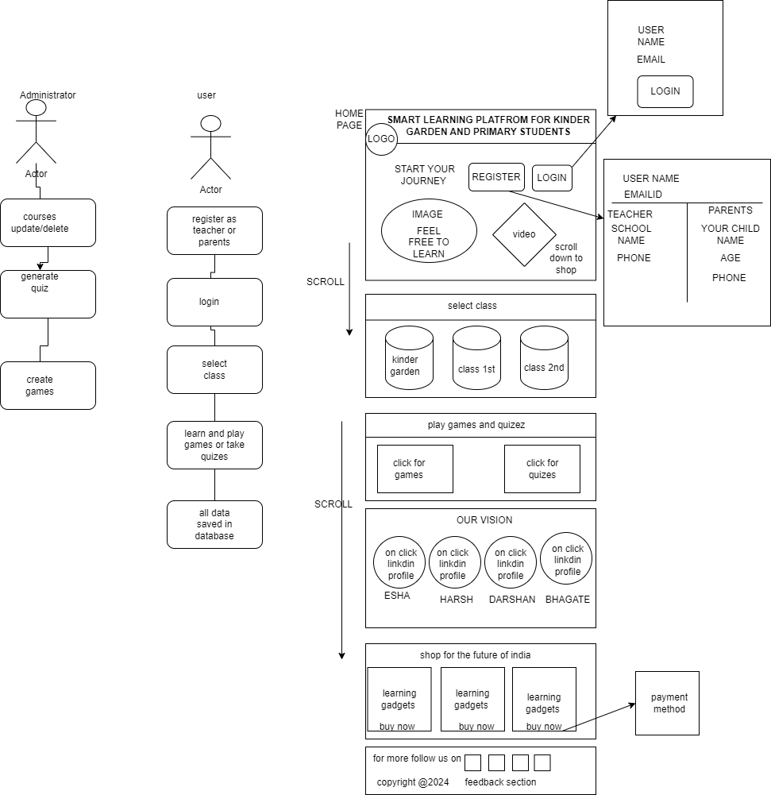
Use Case Diagram

Slide 6
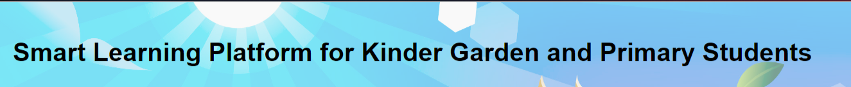

Implementation Till now
Title
Header

Slide 7
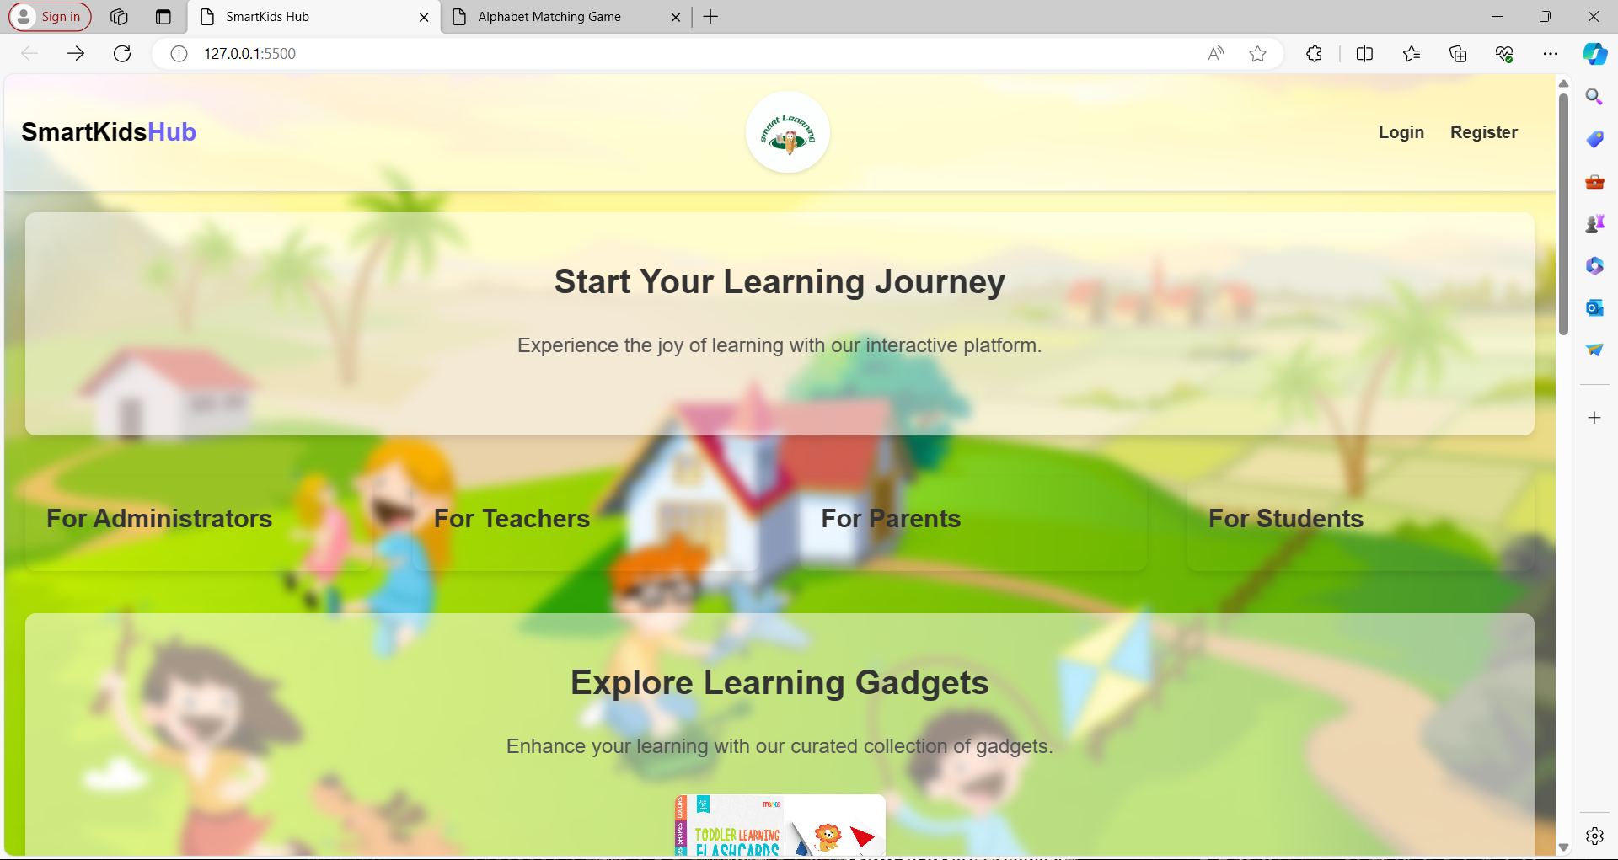

Slide 8
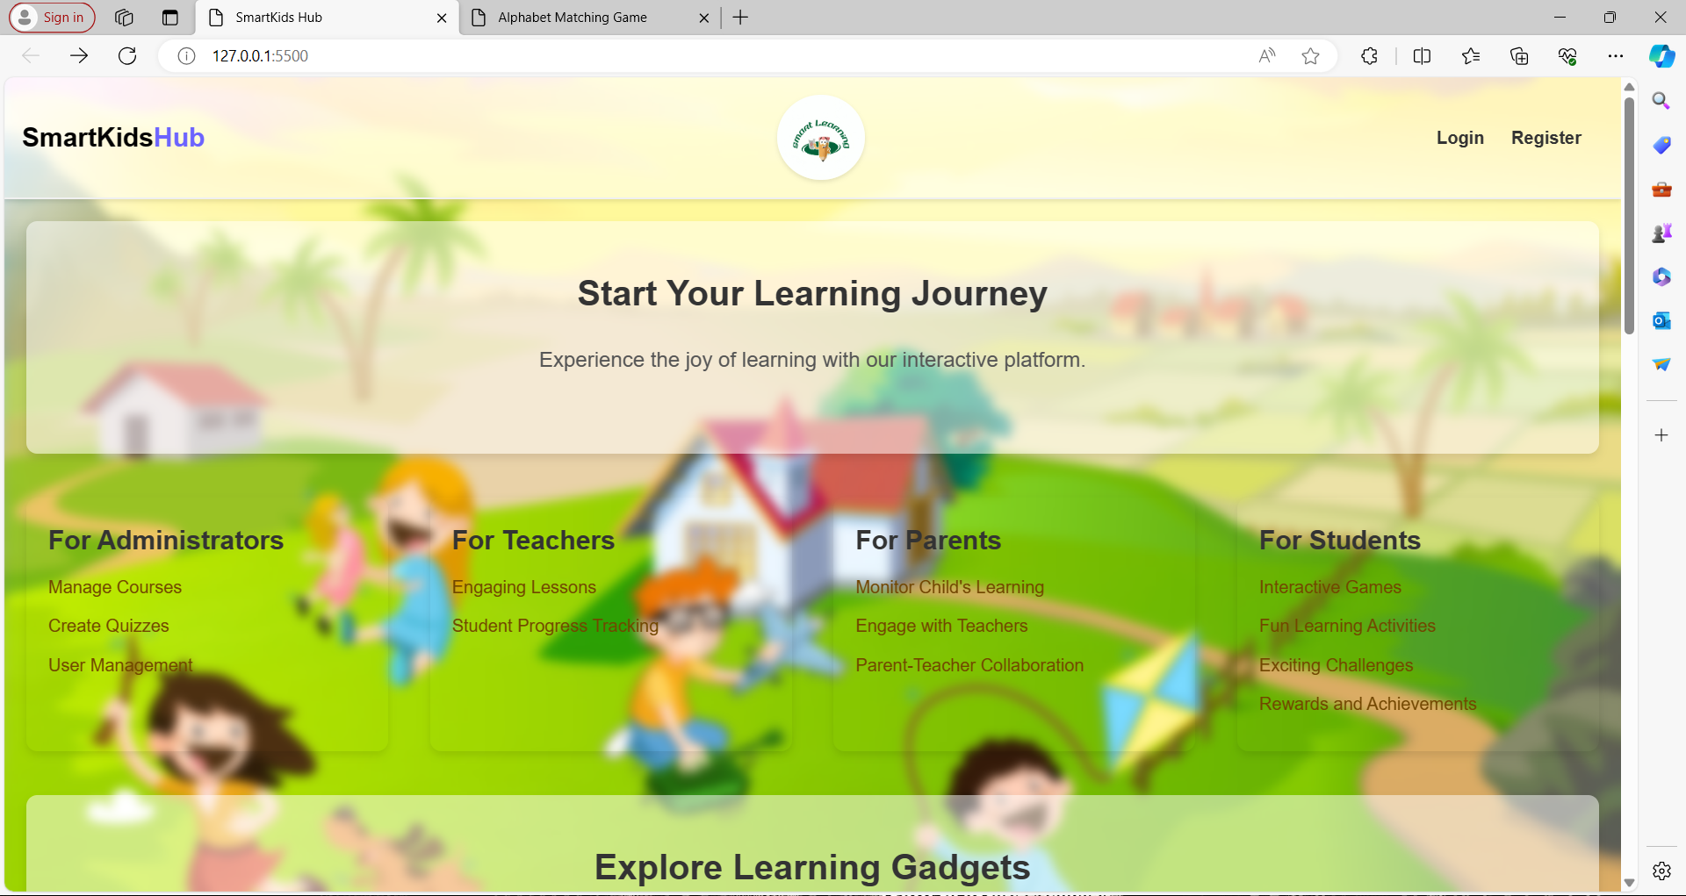

Slide 9
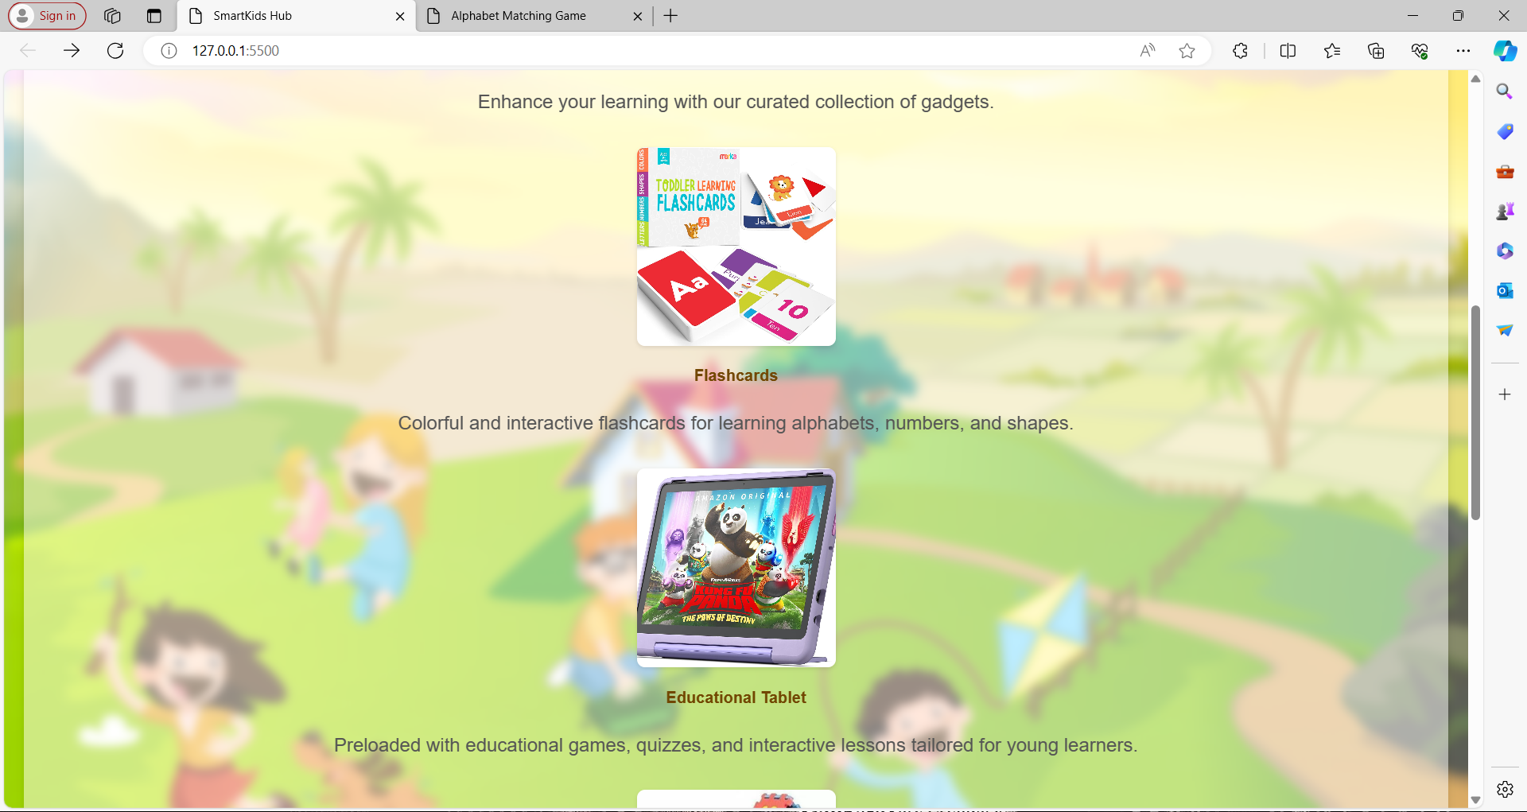

Slide 10
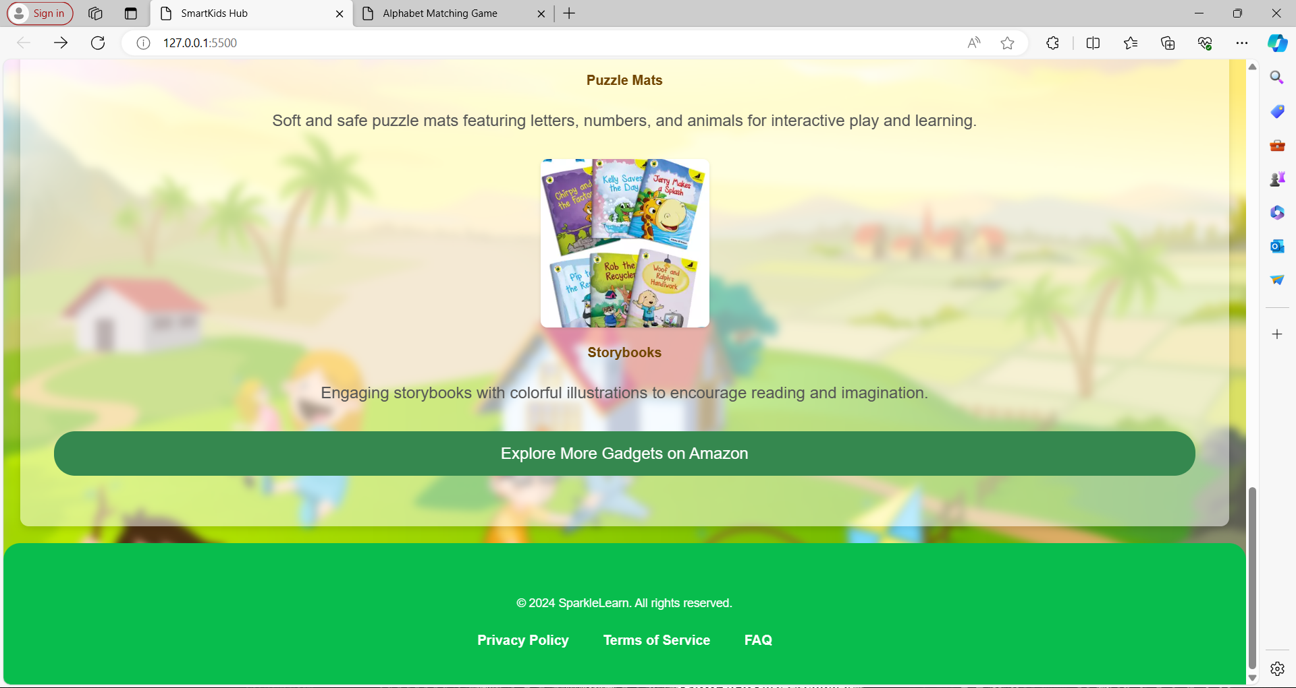

Slide 11
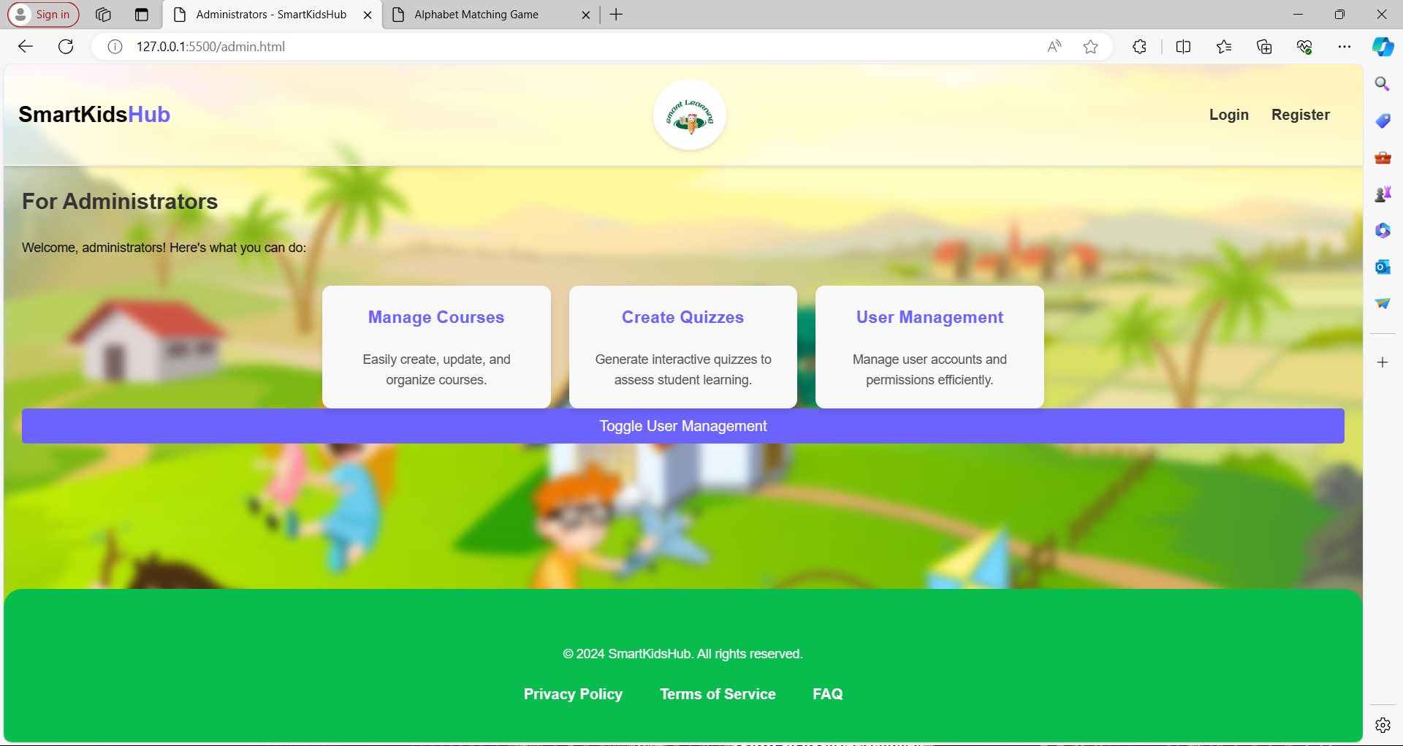

Slide 12
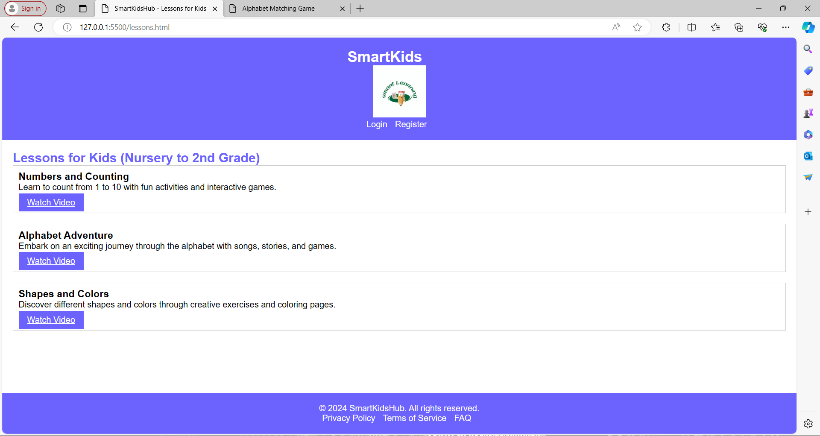

Slide 13
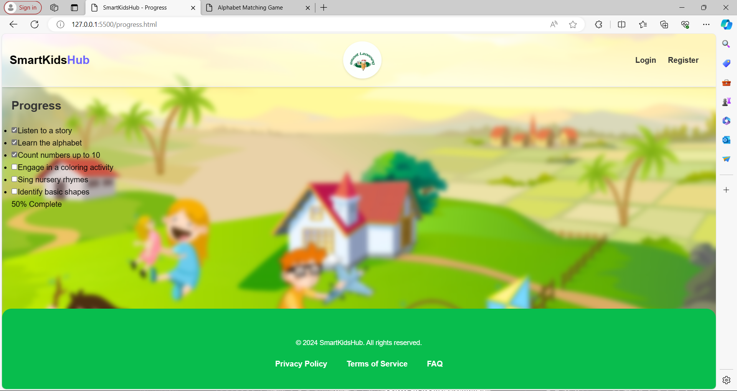

Slide 14
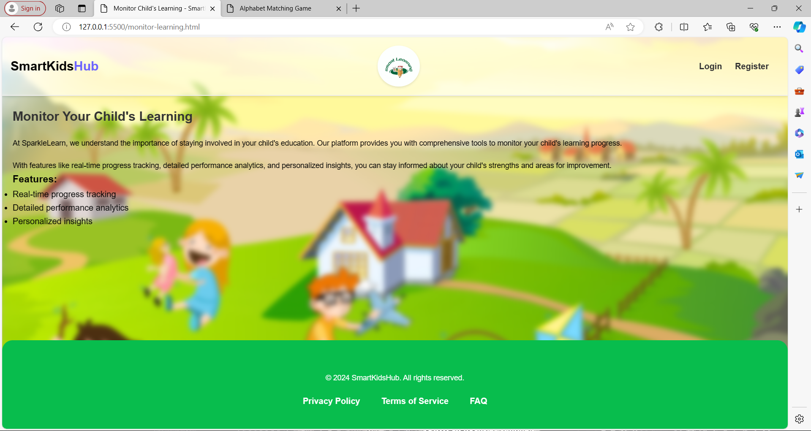

Slide 15


Slide 16


Slide 17
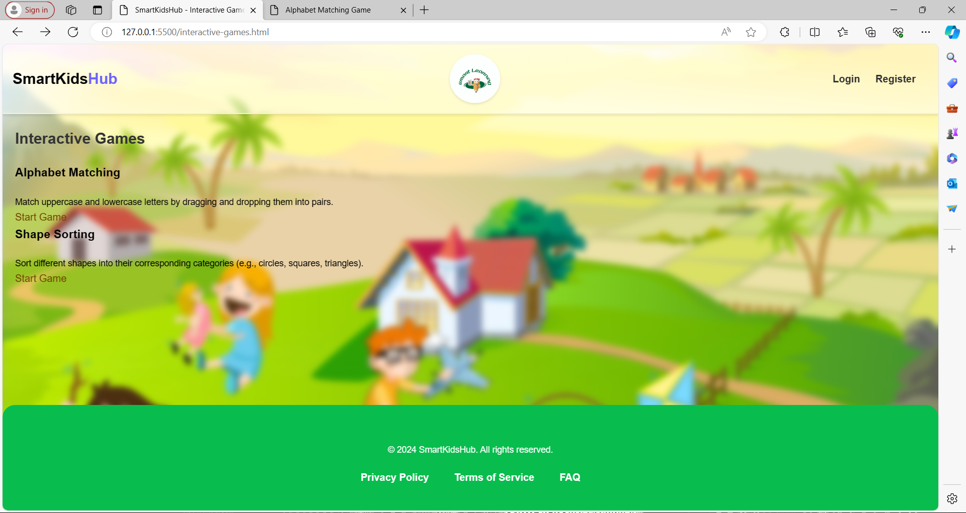

Slide 18
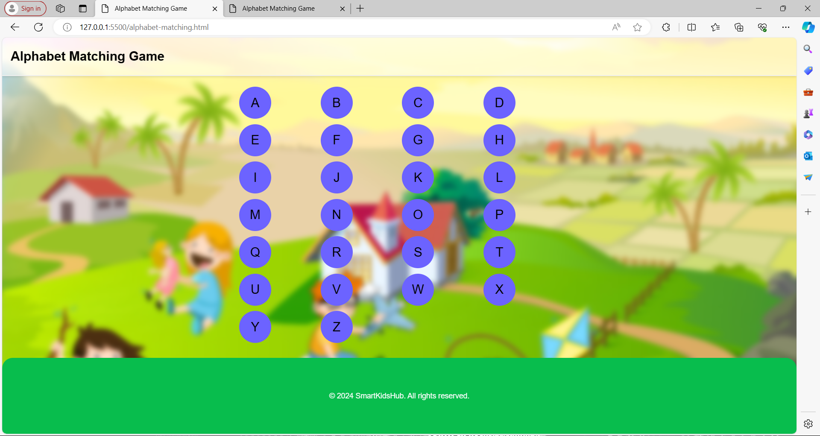

Slide 19
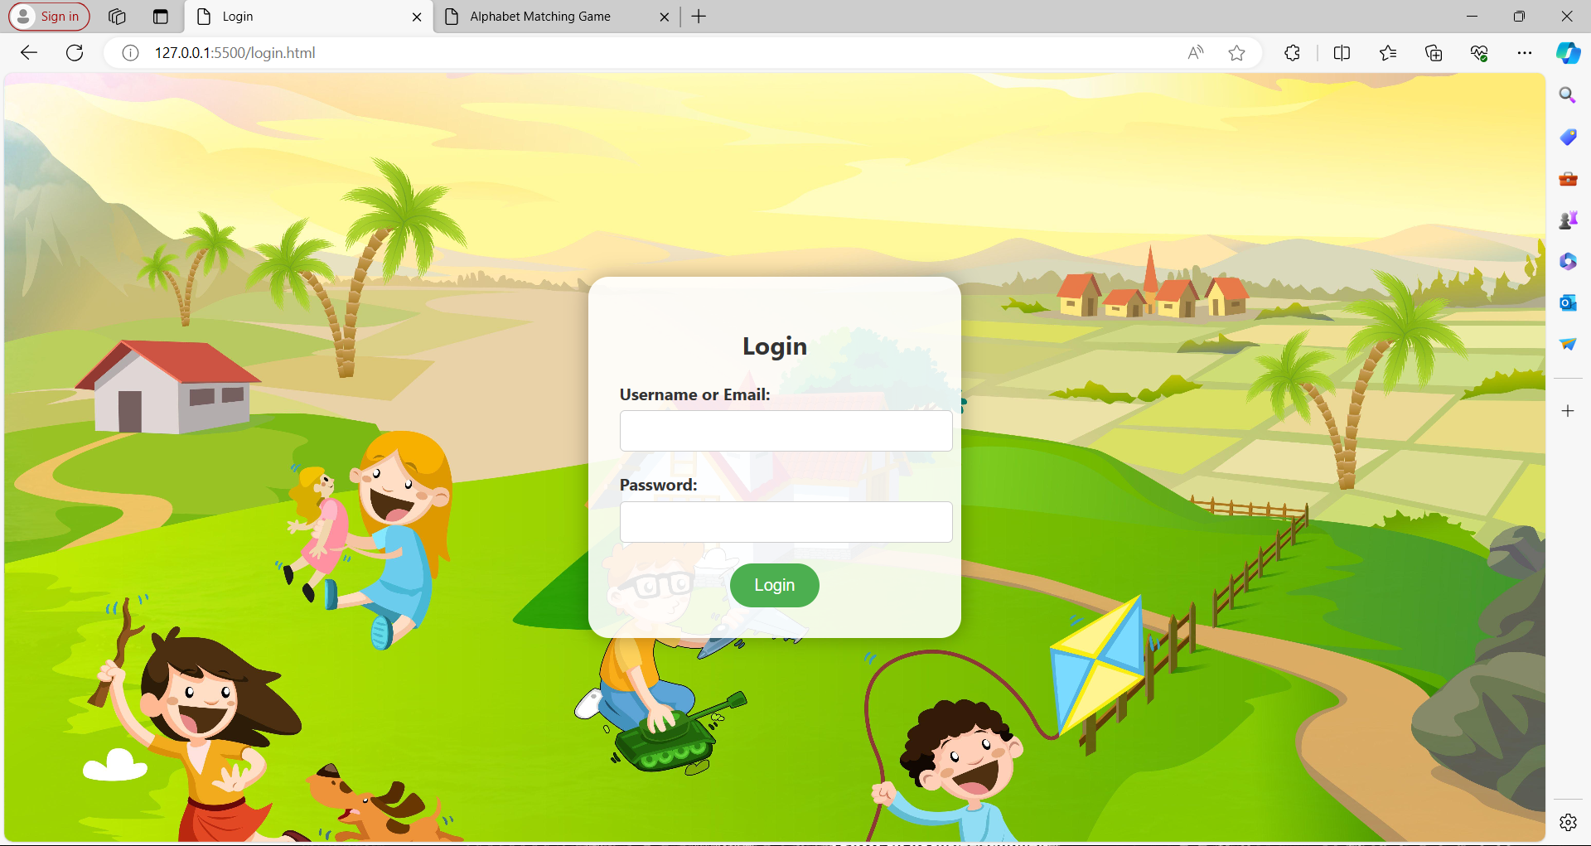

Slide 20
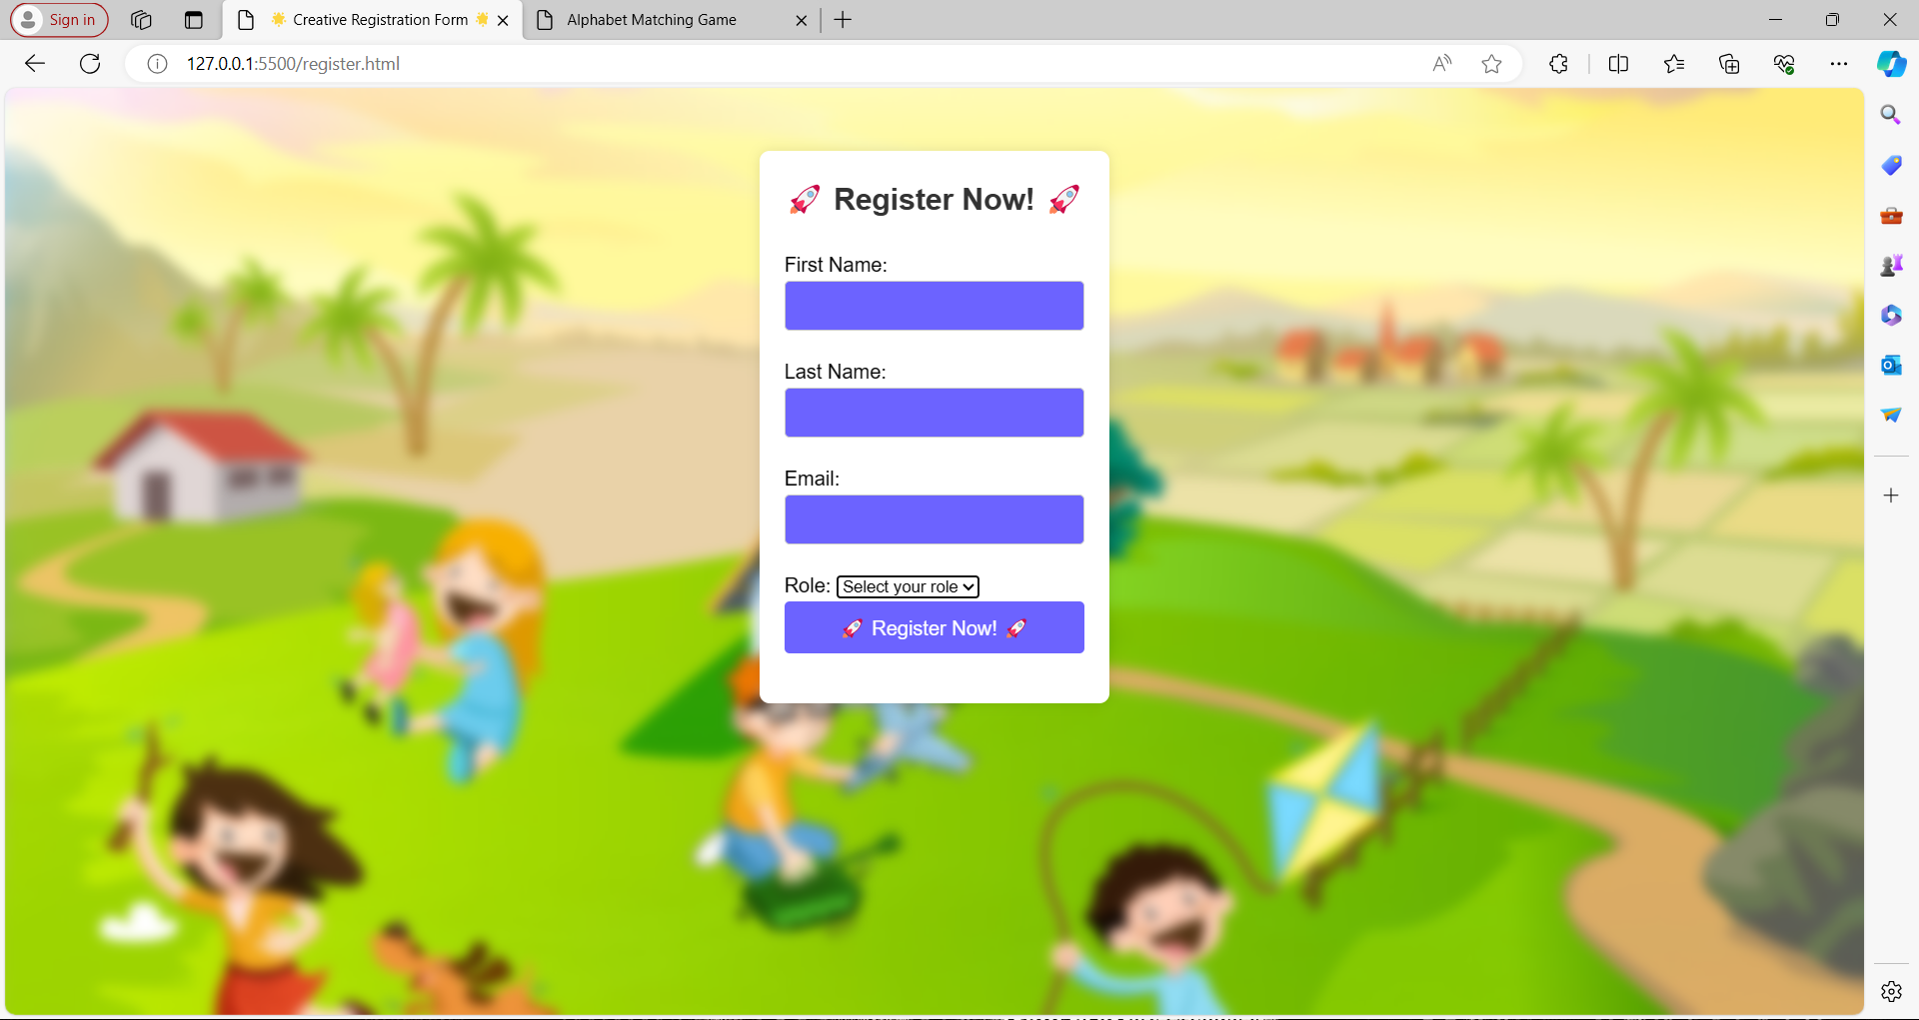

Slide 21
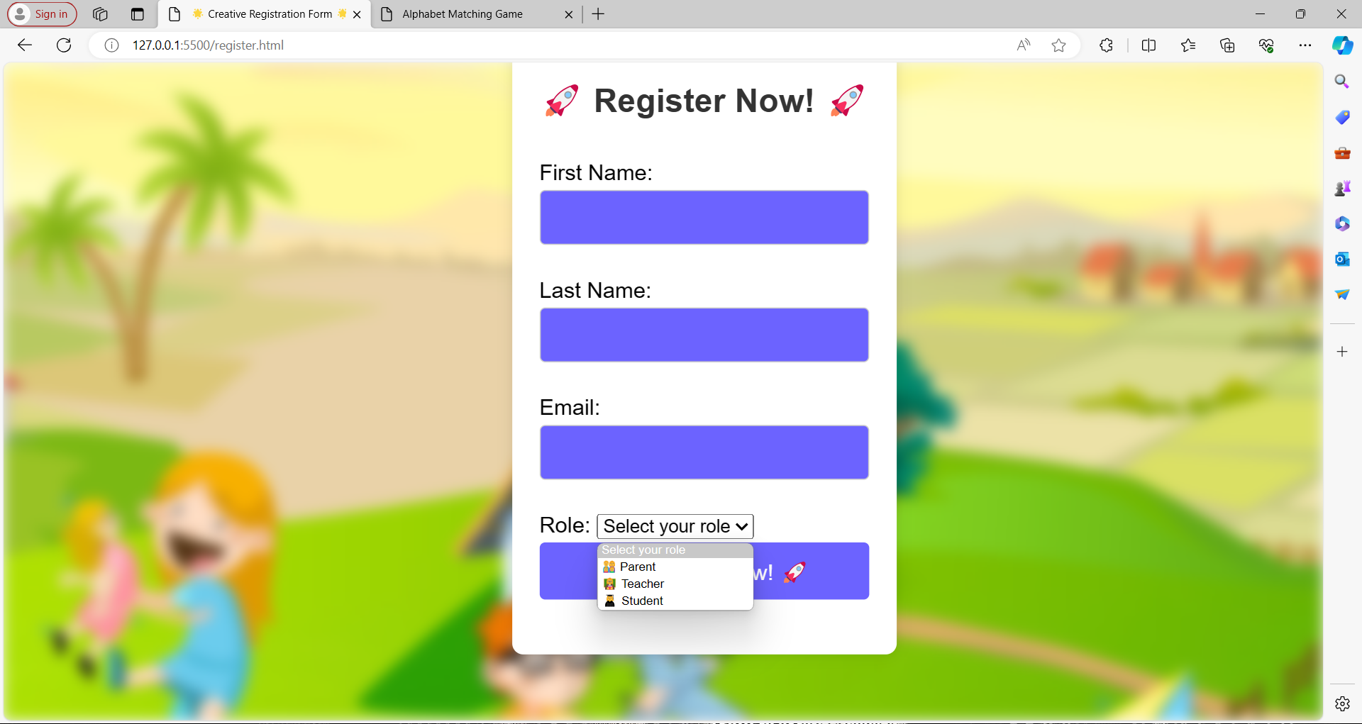

Slide 22
Thank You

